Slide 1
What the heck is

Slide 2
The most widely used
version control system
in the world
(True story)

Slide 3
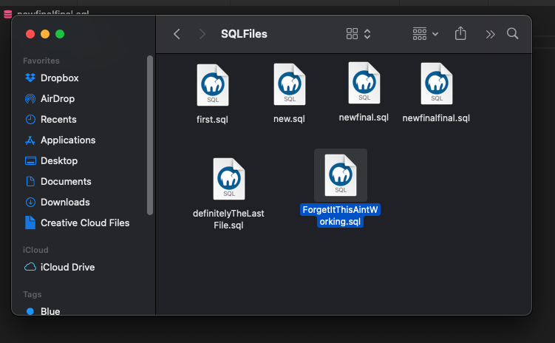
This is a brutal way to save files
…. and we’re all guilty of it

Slide 4
Git is built around a distributed architecture
Every developer's working copy is also its own repository
That means you can work offline and STILL maintain commits

Slide 5
Basics of git
Create a remote REPOSITORY
CLONE the repository to your local machine
ADD some files
COMMIT the changes
PUSH the changes to the remote repository
Create a BRANCH
Make changes, add some files, commit the changes

Slide 6
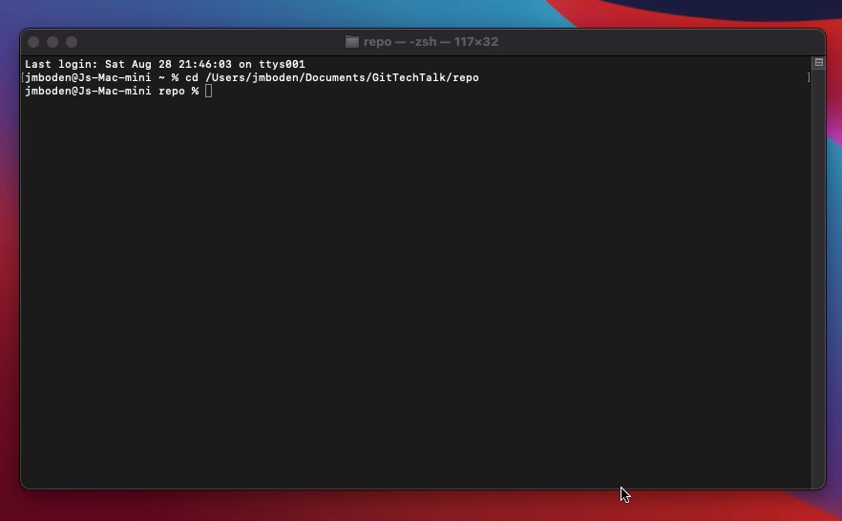

Slide 7
ENTER………
The animation alone sold me on GitKraken
(Another true story)

Slide 8
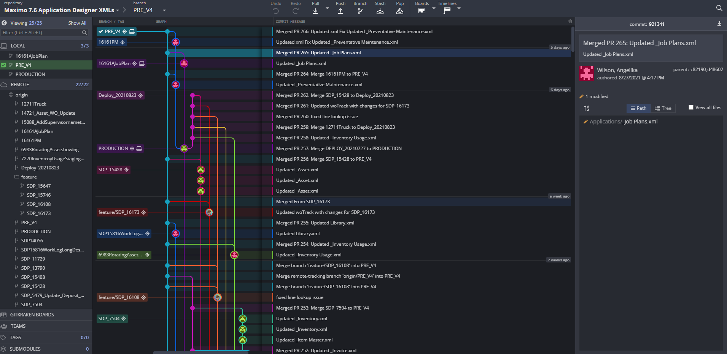
Super duper branching for maximo support

Slide 9
GIT Flow
V 1.0
V 1.1
V 2
MAIN
HOTFIX
RELEASE
DEV
FEATURE

